Slide 1
Distributed Systems
Principles and Paradigms
Chapter 02
Communication
00 – 1

Slide 2
Layered Protocols
  Low-level layers
  Transport layer
  Application layer
  Middleware layer
Remote procedure call (RPC)
Sun RPC
DCE & DCE RPC
Remote Method Invocation
Message-Oriented Communication
Stream-Oriented Communication
02 – 1 Communication/2.1 Layered Protocols

Slide 3
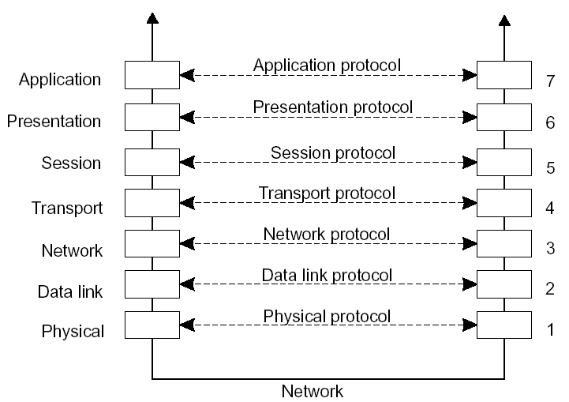
Basic Networking Model
Open Systems Interconnection Reference Model (Zimmerman, 1983)
Also called ISO OSI or OSI Model
ISO – International Standards Organization
02 – 2 Communication/2.1 Layered Protocols

Slide 4
Low-level layers
Physical layer: contains the specification and implementation of bits, and their transmission between sender and receiver
Data link layer: prescribes the transmission of a series of bits into a frame to allow for error and flow control
Network layer: describes how packets in a network of computers are to be routed.
Observation: for many distributed systems, the lowest level interface is that of the network layer.
02 – 3 Communication/2.1 Layered Protocols

Slide 5
Transport Layer
Important: The transport layer provides the actual communication facilities for most distributed systems.
Standard Internet protocols:
  TCP: connection-oriented, reliable, stream-oriented communication
  UDP: unreliable (best-effort) datagram communication
Note: IP multicasting is generally considered a standard available service.
02 – 4 Communication/2.1 Layered Protocols

Slide 6
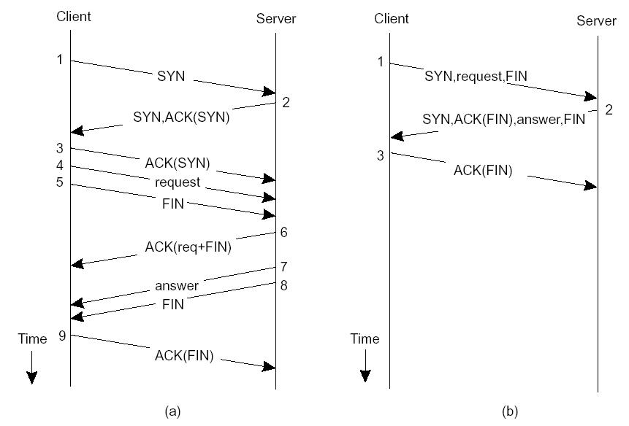
Client–Server TCP
TCP for transactions (T/TCP): A transport protocol aimed to support client–server interaction
Normal operation of TCP Transactional TCP
02 – 5 Communication/2.1 Layered Protocols

Slide 7
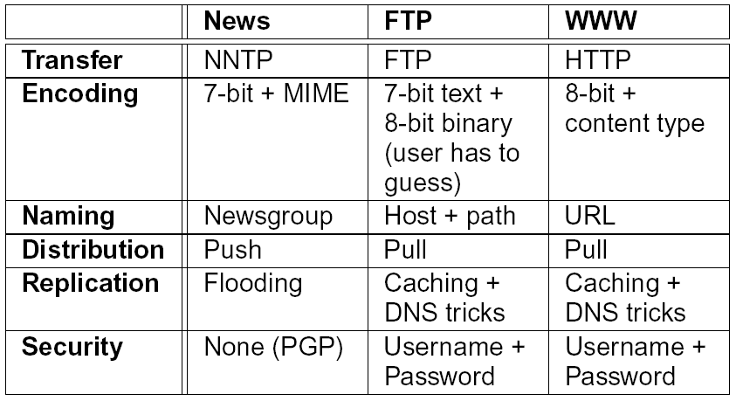
Application Layer
Observation: Many application protocols are directly implemented on top of transport protocols, doing a lot of application-independent work.
02 – 6 Communication/2.1 Layered Protocols

Slide 8
Middleware Layer
Observation: Middleware is invented to provide common services and protocols that can be used by many different applications:
  A rich set of communication protocols, but which allow different applications to communicate
  Marshaling and unmarshaling of data, necessary for integrated systems
  Naming protocols, so that different applications can easily share resources
  Security protocols, to allow different applications to communicate in a secure way
  Scaling mechanisms, such as support for replication and caching
02 – 7 Communication/2.1 Layered Protocols

Slide 9
Remote Procedure Call (RPC)
Basic RPC operation
Parameter passing
Variations
02 – 8 Communication/2.2 Remote Procedure Call

Slide 10
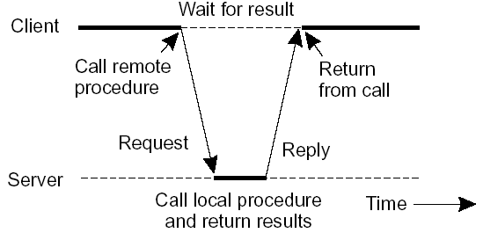
Basic RPC Operation
Observations:
Application developers are familiar with simple procedure model
Well-engineered procedures operate in isolation (black box)
There is no fundamental reason not to execute procedures on separate machines
Conclusion: communication between caller & callee can be hidden by using procedure-call mechanism.
02 – 9 Communication/2.2 Remote Procedure Call

Slide 11
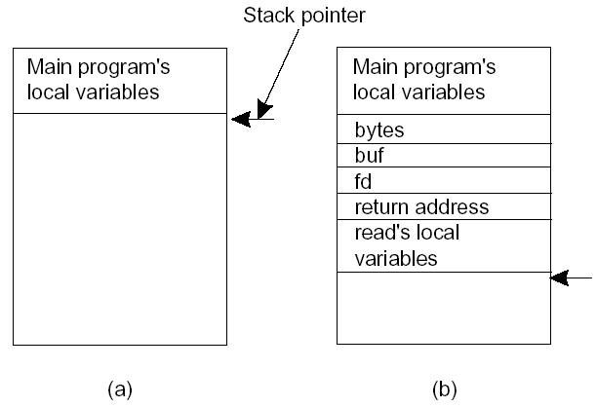
RPC Implementation (1/2)
Local procedure call:
  1: Push parameter values of the procedure on a stack
  2: Call procedure
  3: Use stack for local variables
  4: Pop results (in parameters)
Principle: “communication” with local procedure is handled by copying data to/from the stack (with a few exceptions)
02 – 10 Communication/2.2 Remote Procedure Call

Slide 12
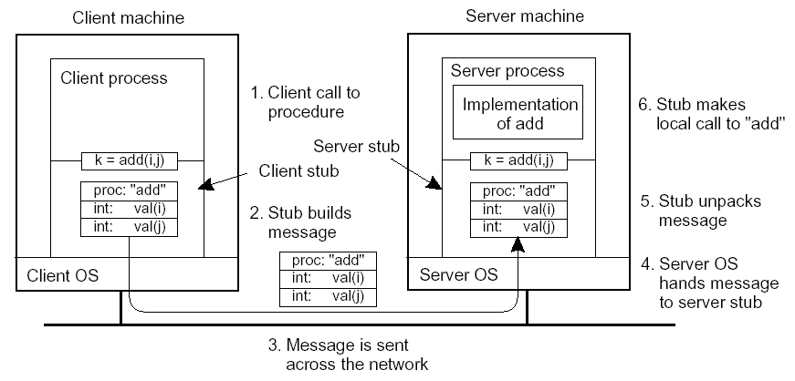
RPC Implementation (2/2)
Steps involved in doing a remote “add” operation
02 – 11 Communication/2.2 Remote Procedure Call

Slide 13
RPC: Parameter Passing (1/2)
Parameter marshaling: There’s more than just wrapping parameters into a message:
  Client and server machines may have different data representations (think of byte ordering)
  Wrapping a parameter means transforming a value into a sequence of bytes
  Client and server have to agree on the same encoding:
    How are basic data values represented (integers, floats, characters)?
    How are complex data values represented (arrays, unions)?
  Client and server need to properly interpret messages, transforming them into machine-dependent representations.
02 – 12 Communication/2.2 Remote Procedure Call

Slide 14
RPC: Parameter Passing (2/2)
RPC parameter passing:
  RPC assumes copy in/copy out semantics:
  while procedure is executed, nothing can be assumed about parameter values.
  RPC assumes all data that is to be operated on is passed by parameters.
  Excludes passing references to (global) data.
Conclusion: full access transparency cannot be realized.
Observation: If we introduce a remote reference mechanism, access transparency can be enhanced:
  Remote reference offers unified access to remote data
  Remote references can be passed as parameter in RPCs
02 – 13 Communication/2.2 Remote Procedure Call

Slide 15
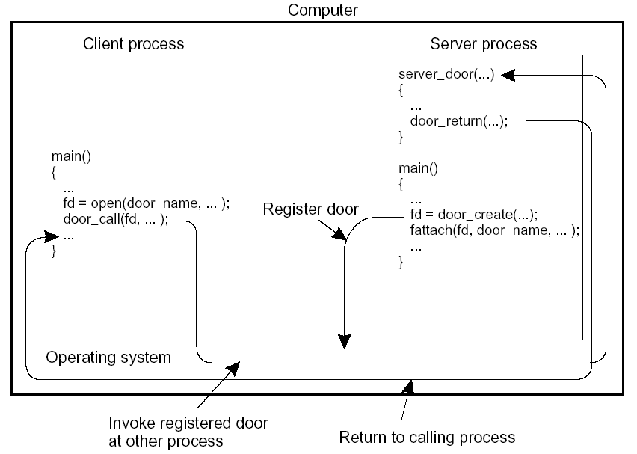
Local RPCs: Doors
Essence: Try to use the RPC mechanism as the only mechanism for interprocess communication (IPC). Doors are RPCs implemented for processes on the same machine.
02 – 14 Communication/2.2 Remote Procedure Call

Slide 16
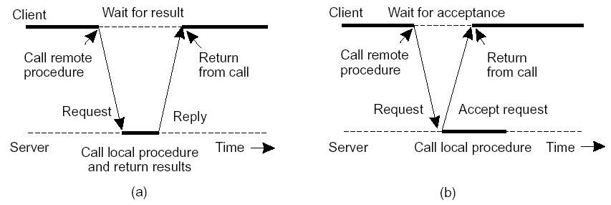
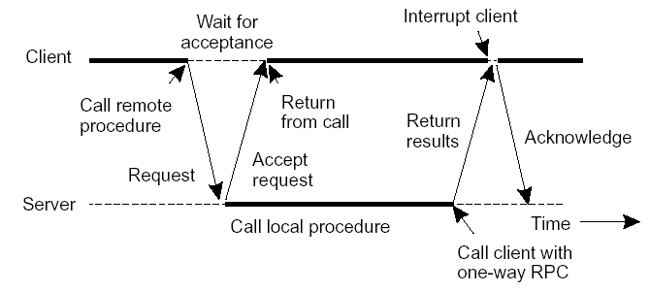
Asynchronous RPCs
Essence: Try to get rid of the strict request-reply behavior, but let the client continue without waiting for an answer from the server.
Variation: deferred synchronous RPC:
02 – 15 Communication/2.2 Remote Procedure Call

Slide 17
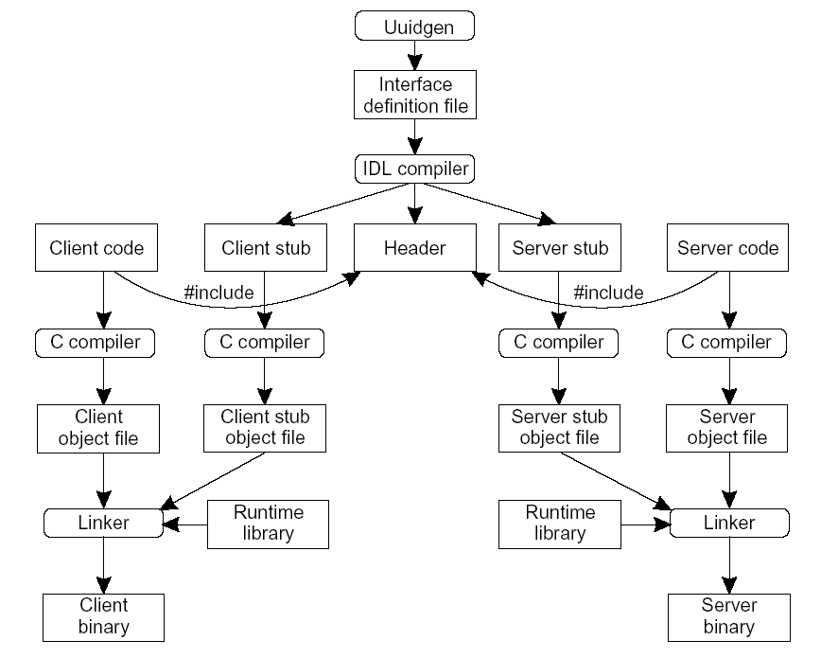
RPC in Practice
Essence: Let the developer concentrate on only the client- and server-specific code; let the RPC system (generators and libraries) do the rest.
02 – 16 Communication/2.2 Remote Procedure Call

Slide 18
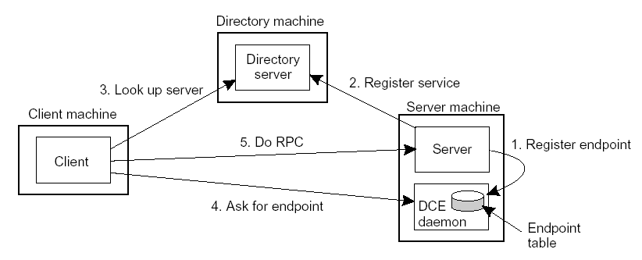
Issues: (1) Client must locate server machine, and (2) locate the server. Read Introduction to DCE in Section 2.2.4
Example: DCE uses a separate daemon for each server machine.
Client-to-Server Binding (DCE)
02 – 17 Communication/2.2 Remote Procedure Call

Slide 19
Remote Object Invocation
Distributed objects
Remote method invocation
Parameter passing
02 – 18 Communication/2.3 Remote Object Invocation

Slide 20
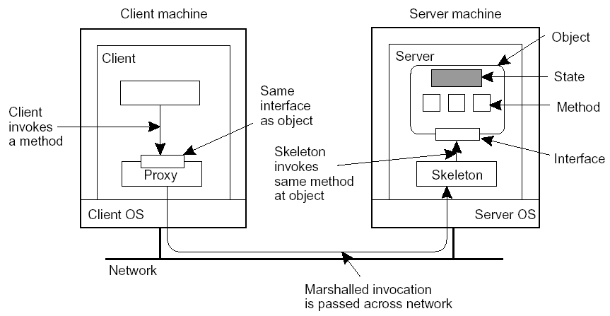
Remote Distributed Objects (1/2)
Data and operations encapsulated in an object
Operations are implemented as methods, and are accessible through interfaces
Object offers only its interface to clients
Object server is responsible for a collection of objects
Client stub (proxy) implements interface
Server skeleton handles (un)marshaling and object invocation
02 – 19 Communication/2.3 Remote Object Invocation

Slide 21
Remote Distributed Objects (2/2)
Compile-time objects: Language-level objects, from which proxy and skeletons are automatically generated.
Runtime objects: Can be implemented in any language, but require use of an object adapter that makes the implementation appear as an object.
Transient objects: live only by virtue of a server: if the server exits, so will the object.
Persistent objects: live independently from a server: if a server exits, the object’s state and code remain (passively) on disk.
02 – 20 Communication/2.3 Remote Object Invocation

Slide 22
Client-to-Object Binding (1/2)
Object reference: Having an object reference allows a client to bind to an object:
  Reference denotes server, object, and communication protocol
  Client loads associated stub code
  Stub is instantiated and initialized for specific object
Two ways of binding:
  Implicit: Invoke methods directly on the referenced object
  Explicit: Client must first explicitly bind to object before invoking it
02 – 21 Communication/2.3 Remote Object Invocation

Slide 23
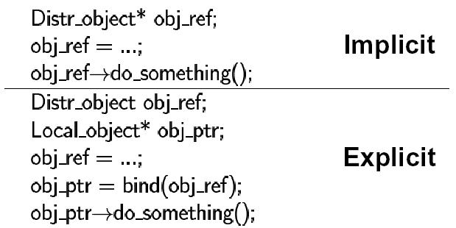
Client-to-Object Binding (2/2)
Some remarks:
Reference may contain a URL pointing to an implementation file
(Server, object) pair is enough to locate target object
We need only a standard protocol for loading and instantiating code
Observation: Remote-object references allow us to pass references as parameters. This was difficult with ordinary RPCs.
02 – 22 Communication/2.3 Remote Object Invocation

Slide 24
Remote Method Invocation
Basics: (Assume client stub and server skeleton are in place)
  Client invokes method at stub
  Stub marshals request and sends it to server
  Server ensures referenced object is active:
    Create separate process to hold object
    Load the object into server process
  Request is unmarshaled by object’s skeleton, and referenced method is invoked
  If request contained an object reference, invocation is applied recursively (i.e., server acts as client)
  Result is marshaled and passed back to client
  Client stub unmarshals reply and passes result to client application
02 – 23 Communication/2.3 Remote Object Invocation

Slide 25
RMI: Parameter Passing (1/2)
Object reference: Much easier than in the case of RPC:
  Server can simply bind to referenced object, and invoke methods
  Unbind when referenced object is no longer needed
Object-by-value: A client may also pass a complete object as parameter value:
  An object has to be marshaled:
    Marshall its state
    Marshall its methods, or give a reference to where an implementation can be found
  Server unmarshals object. Note that we have now created a copy of the original object.
  Object-by-value passing tends to introduce nasty problems
02 – 24 Communication/2.3 Remote Object Invocation

Slide 26
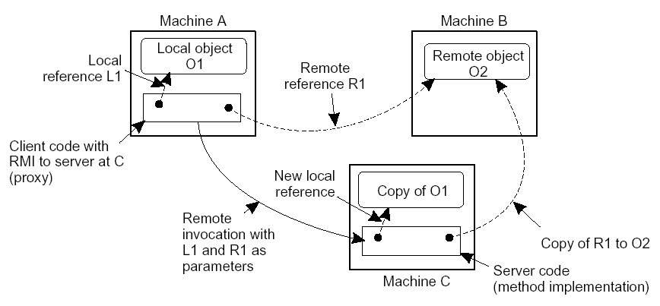
RMI: Parameter Passing (2/2)
Passing of an object by reference or by value
Question: What’s an alternative implementation for a remote-object reference?
02 – 25 Communication/2.3 Remote Object Invocation

Slide 27
Message-Oriented
Communication
Synchronous versus asynchronous communications
Message-Queuing System
Message Brokers
Example: IBM MQSeries
02 – 26 Communication/2.4 Message-Oriented Communication

Slide 28
Synchronous Communication
Some observations: Client/Server computing is generally based on a model of synchronous communication:
  Client and server have to be active at the time of communication
  Client issues request and blocks until it receives reply
  Server essentially waits only for incoming requests, and subsequently processes them
Drawbacks of synchronous communication:
  Client cannot do any other work while waiting for reply
  Failures have to be dealt with immediately (the client is waiting)
  In many cases the model is simply not appropriate (mail, news)
02 – 27 Communication/2.4 Message-Oriented Communication

Slide 29
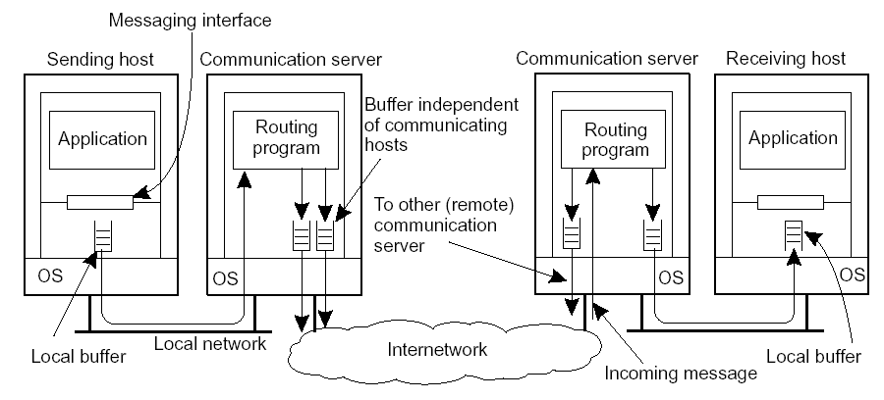
Asynchronous Communication: Messaging
Message-oriented middleware: Aims at high-level asynchronous communication:
  Processes send each other messages, which are queued
  Sender need not wait for immediate reply, but can do other things
  Middleware often ensures fault tolerance
02 – 28 Communication/2.4 Message-Oriented Communication

Slide 30
Persistent vs. Transient
Communication
Persistent communication: A message is stored at a communication server as long as it takes to deliver it at the receiver.
Transient communication: A message is discarded by a communication server as soon as it cannot be delivered at the next server, or at the receiver.
02 – 29 Communication/2.4 Message-Oriented Communication

Slide 31
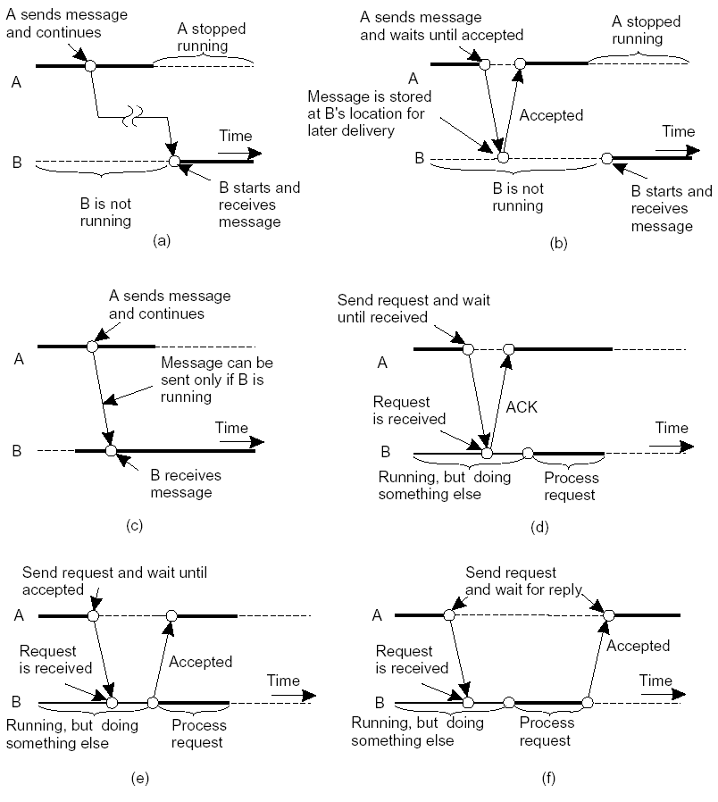
Messaging Combinations
02 – 30 Communication/2.4 Message-Oriented Communication

Slide 32
Message-Oriented Middleware
Essence: Asynchronous persistent communication through support of middleware-level queues. Queues correspond to buffers at communication servers.
Canonical example: IBM MQSeries
02 – 31 Communication/2.4 Message-Oriented Communication

Slide 33
IBM MQSeries (1/3)
Basic concepts:
  Application-specific messages are put into, and removed from queues
  Queues always reside under the regime of a queue manager
  Processes can put messages only in local queues, or through an RPC mechanism
Message transfer:
  Messages are transferred between queues
  Message transfer between queues at different processes, requires a channel
  At each endpoint of channel is a message channel agent
    Setting up channels using lower-level network communication facilities (e.g., TCP/IP)
    (Un)wrapping messages from/in transport-level packets
    Sending/receiving packets
02 – 32 Communication/2.4 Message-Oriented Communication

Slide 34
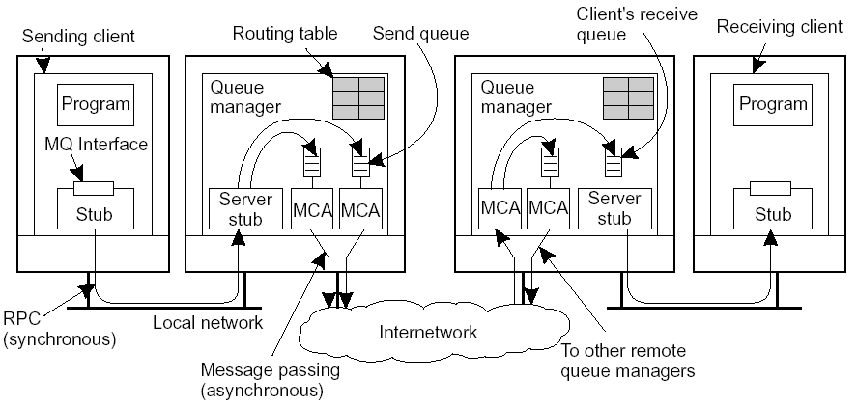
IBM MQSeries (2/3)
Channels are inherently unidirectional
MQSeries provides mechanisms to automatically start MCAs when messages arrive, or to have a receiver set up a channel
Any network of queue managers can be created; routes are set up manually (system administration)
02 – 33 Communication/2.4 Message-Oriented Communication

Slide 35
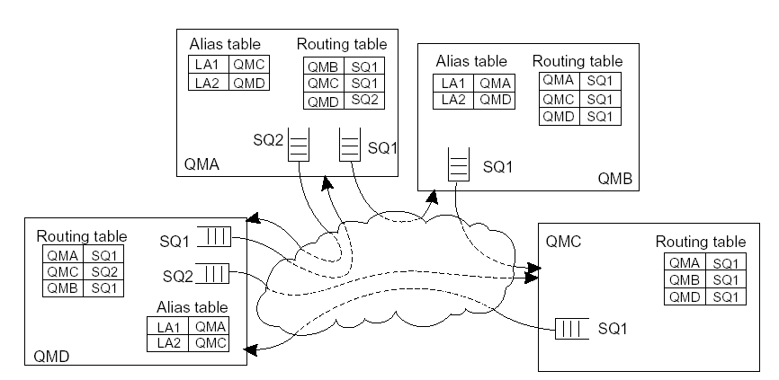
IBM MQSeries (3/3)
Routing: By using logical names, in combination with name resolution to local queues, it is possible to put a message in a remote queue
Question: What’s a major problem here?
02 – 34 Communication/2.4 Message-Oriented Communication

Slide 36
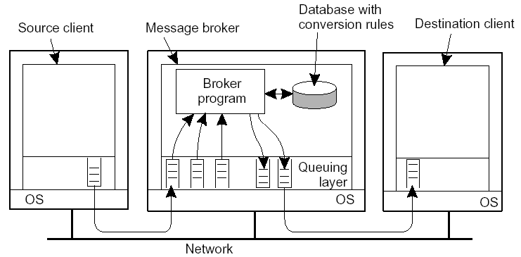
Message Broker
Observation: Message queuing systems assume a common messaging protocol: all applications agree on message format (i.e., structure and data representation)
Message broker: Centralized component that takes care of application heterogeneity in a message-queuing system:
  Transforms incoming messages to target format, possibly using intermediate representation
  May provide subject-based routing capabilities
  Acts very much like an application gateway
02 – 35 Communication/2.4 Message-Oriented Communication

Slide 37
Stream-Oriented Communication
Support for continuous media
Streams in distributed systems
Stream management
02 – 36 Communication/2.5 Stream-Oriented Communication

Slide 38
Continuous Media
Observation: All communication facilities discussed so far are essentially based on a discrete, that is time independent exchange of information
Continuous media: Characterized by the fact that values are time dependent:
  Audio
  Video
  Animations
  Sensor data (temperature, pressure, etc.)
Transmission modes: Different timing guarantees with respect to data transfer:
  Asynchronous: no restrictions with respect to when data is to be delivered
  Synchronous: define a maximum end-to-end delay for individual data packets
  Isochronous: define a maximum and minimum end-to-end delay (jitter is bounded)
02 – 37 Communication/2.5 Stream-Oriented Communication

Slide 39
Stream (1/2)
Definition: A (continuous) data stream is a connection-oriented communication facility that supports isochronous data transmission
Some common stream characteristics:
  Streams are unidirectional. There is generally a single source, and one or more sinks
  Often, either the sink and/or source is a wrapper around hardware (e.g., camera, CD device, TV monitor, dedicated storage)
Stream types:
  Simple: consists of a single flow of data, e.g., audio or video
  Complex: multiple data flows, e.g., stereo audio or combination audio/video
02 – 38 Communication/2.5 Stream-Oriented Communication

Slide 40
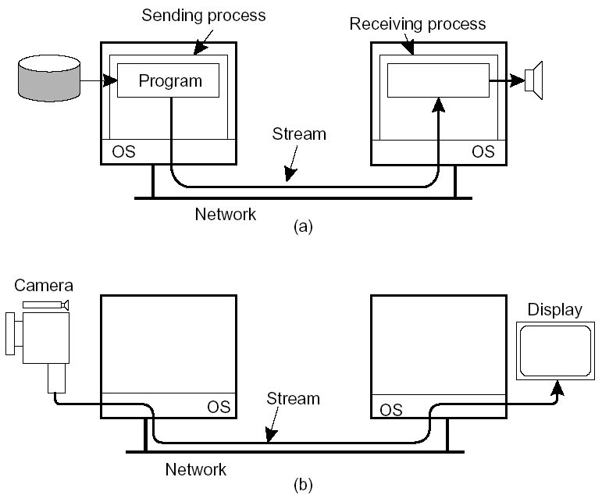
Stream (2/2)
Issue: Streams can be set up between two processes at different machines, or directly between two different devices. Combinations are possible as well.
02 – 39 Communication/2.5 Stream-Oriented Communication

Slide 41
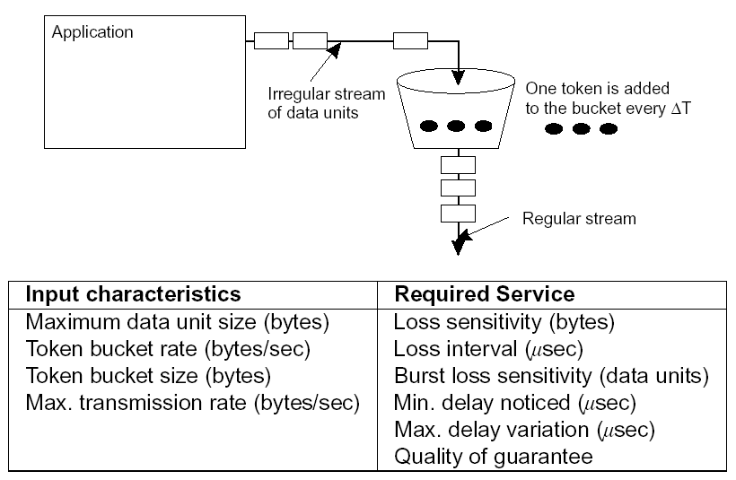
Streams and QoS
Essence: Streams are all about timely delivery of data. How do you specify this Quality of Service (QoS)? Make distinction between specification and implementation of QoS.
Flow specification: Use a token-bucket model and express QoS in that model.
02 – 40 Communication/2.5 Stream-Oriented Communication

Slide 42
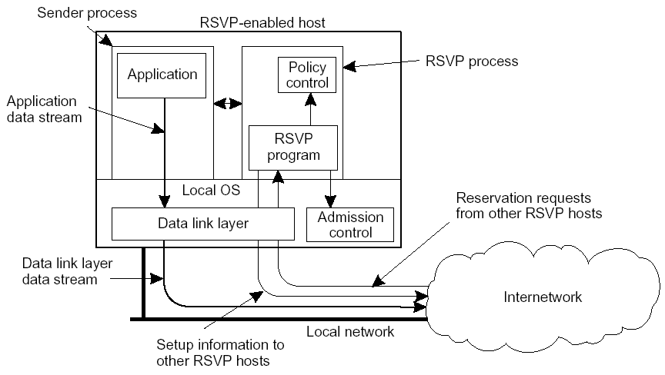
Implementing QoS
Problem: QoS specifications translate to resource reservations in underlying communication system. There is no standard way of (1) QoS specs, (2) describing resources, (3) mapping specs to reservations.
Approach: Use Resource reSerVation Protocol (RSVP) as first attempt. RSVP is a transport-level protocol.
02 – 41 Communication/2.5 Stream-Oriented Communication

Slide 43
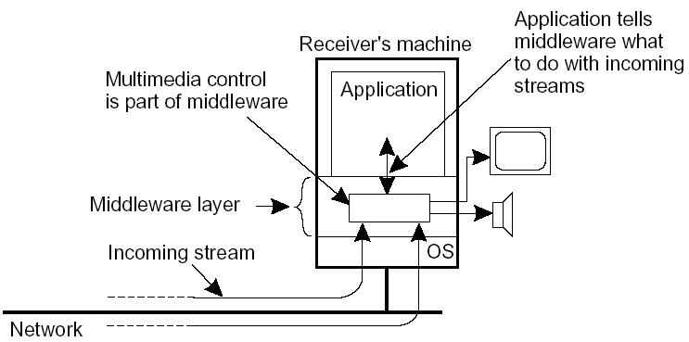
Stream Synchronization
Problem: Given a complex stream, how do you keep the different substreams in synch?
Example: Think of playing out two channels, that together form stereo sound. Difference should be less than 20–30 µsec!
Alternative: multiplex all substreams into a single stream, and demultiplex at the receiver. Synchronization is handled at multiplexing/demultiplexing point (MPEG).
02 – 42 Communication/2.5 Stream-Oriented Communication

